Slide 1
The Basics to Programming 1
A Series of Bite Size Lessons for Programming
Introduction, Strings, and Numbers
By Tariq Chatur

Slide 2
Introduction
These lessons are very short as they are intended to introduce you to programming
The structure of each step will be the same:
Introduce a problem, and write code together to solve it.
Reflect on the code
Use what you have learned to accomplish a similar task
At the end of each lesson there will be a series of exercises, of elevating difficulty with solutions to reflect on the lesson
Once a lesson is complete, the information will not be revisited, please refer back if you need to for further exercises.

Slide 3
Understanding the Basic Concept
Basic Coding is giving a computer a single task to do at a time.
Any problem that you can break down into consecutive tasks can be replicated by a computer.
Ex. Baking a cake:
Gather ingredients
Mix
Bake
These steps can be broken down further into steps which then can then be completed by a computer. In learning these steps we will use abstract examples to help develop your problem solving skills.

Slide 4
Languages
Every Programming/Scripting language is optimised/restricted for a certain use case. However, in most cases we can ignore these optimisations and just use whatever language we want.
*With complex programs it is often easier to learn a new language than it is to learn how to force your preferred language to work.
We will be using PowerShell for this introduction as it is available for us to use.
Open your ISE and click the play button to see if scripts can be run on your computer
If you have an Execution Policy Restriction run this line and accept all.
Set-ExecutionPolicy Unrestricted -Scope CurrentUser

Slide 5
PowerShell
Programming languages use a variety of keywords that have special meanings. It is imperative that we have access to these words so we can learn what they do and use them.
Most languages have something called an API which contains all this information. For PowerShell it can be found here:
https://docs.microsoft.com/en-us/powershell/module/microsoft.powershell.utility/write-host?view=powershell-7

Slide 6
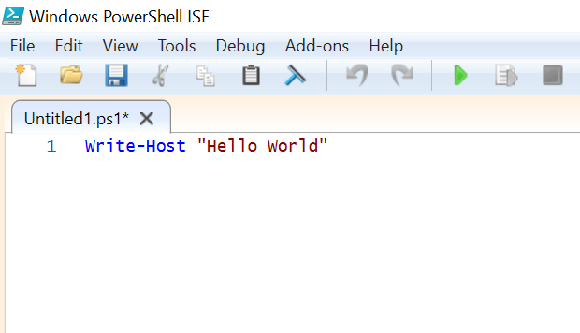
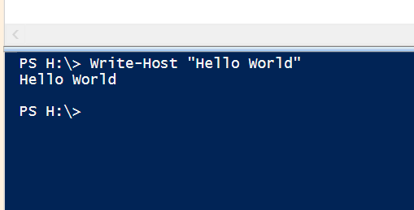
Hello World
It’s time to make your first script. In programming we use Hello World to test whether we can execute code on our systems.
Hello World is a simple program. It just print the words “Hello World”.
In PowerShell you can accomplish this by doing the following and then clicking the Run button:
Please copy this code and run it to see if you get the same output.

Slide 7
Your First Program
Congratulations you just created your first program. Now we will break down the code and learn about what each part does.
Write-Host : Writes whatever is passed into it to the selected output. Default is the command line.
“…” : An indicator that tells the computer that the values inside are words and not code. We call this type of code Strings
So all together, we told the computer to print a value using Write-Host, and that value was the String, Hello World

Slide 8
Exercise 1: Printing to Console
Now that you have been introduced to Write-Host. Your next task is to use Write-Host to print out your Full Name.
Below the rectangle is an example of code that will do just this. Once you are done, check to see if the code is similar.
*There are always many ways to accomplish the same task so there is no right and wrong ways.
Answer
Drag Answer Box Here to see Answer

Slide 9
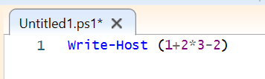

Numbers and Math
Now that you know how to write things to the console, it is time to learn how to use numbers in your code.
Don’t worry, you won’t be doing calculus. Generally speaking basic coding is limited to arithmetic.
Please replicate the code below:

Slide 10

Review of Math
Remember to follow BEDMAS or whatever abbreviation you had learned for the order for arithmetic.
*The reason we use () will be explained in the next lesson
Numbers : These are a type that you can do math on. PowerShell will automatically determine the type of number. But it is good to keep in mind that there are different types of numbers.
Integers: 4/3 = 1
Doubles: 4/3 = 1.333…
This is can cause a lot of issues if you must use one and not the other. You can force an integer to be a double by writing it to the tenths place.
Ex. 4.0/3.0 = 1.333…

Slide 11
Exercise 2: Basic Printing of Math
Now that you have been exposed to some basic math, its time to make the computer do it. Use Write-Host and Numbers to make an equation that equal 3. You must use all these operators: (+, -, /, *, %)
*These are the most common operators that are used everywhere in coding. They are the base to machine learning, graphics, and everything you do on your computer.
Answer
Drag Answer Box Here to see Answer

Slide 12
Review
In this lesson you learned how to print in PowerShell and how to do basic math.
Key Points:
Write-Host
“…”
Numbers (+,-,/,*,%)
The next page will have a series of exercises for you to try with ascending difficulty please try your best and remember that you can get the same output by having different code.

Slide 13


Review Exercises
*Try and Guess the outputs before writing it yourself
Level 1:
Level 2 :
Level 3:
Level 4:
Answer
Answer
Answer
Answer

